Slide 1
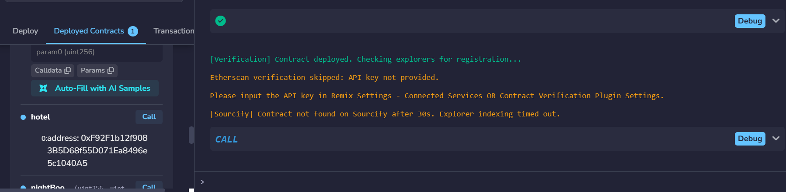
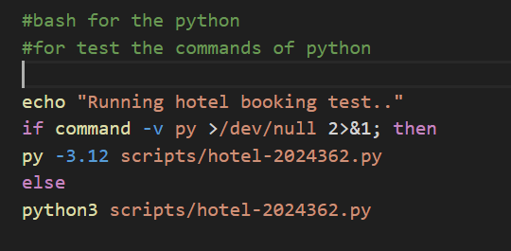
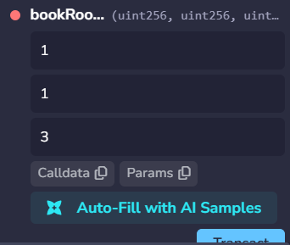
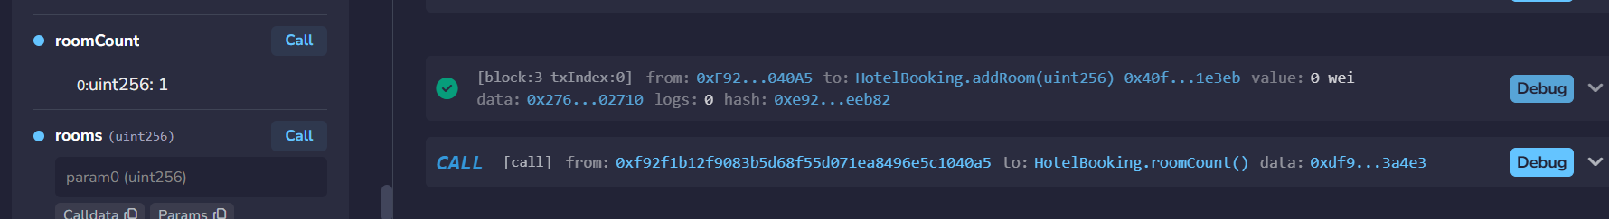
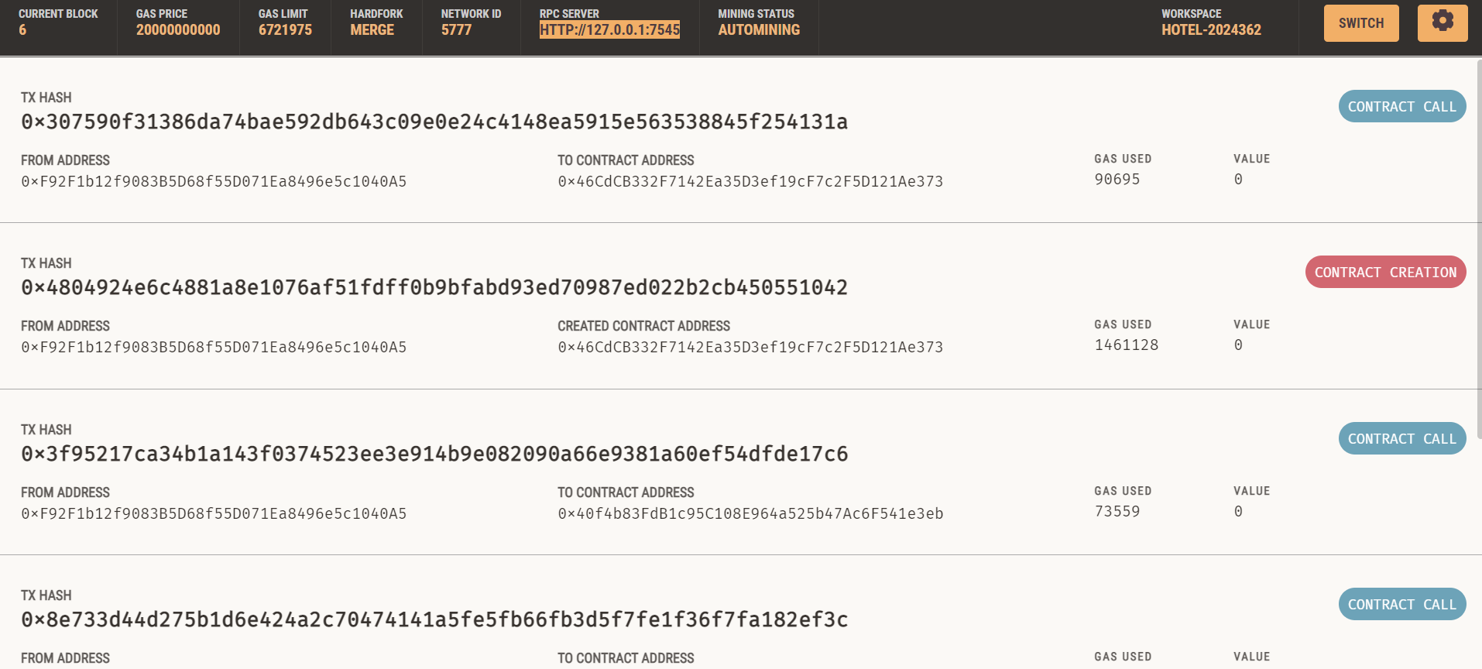
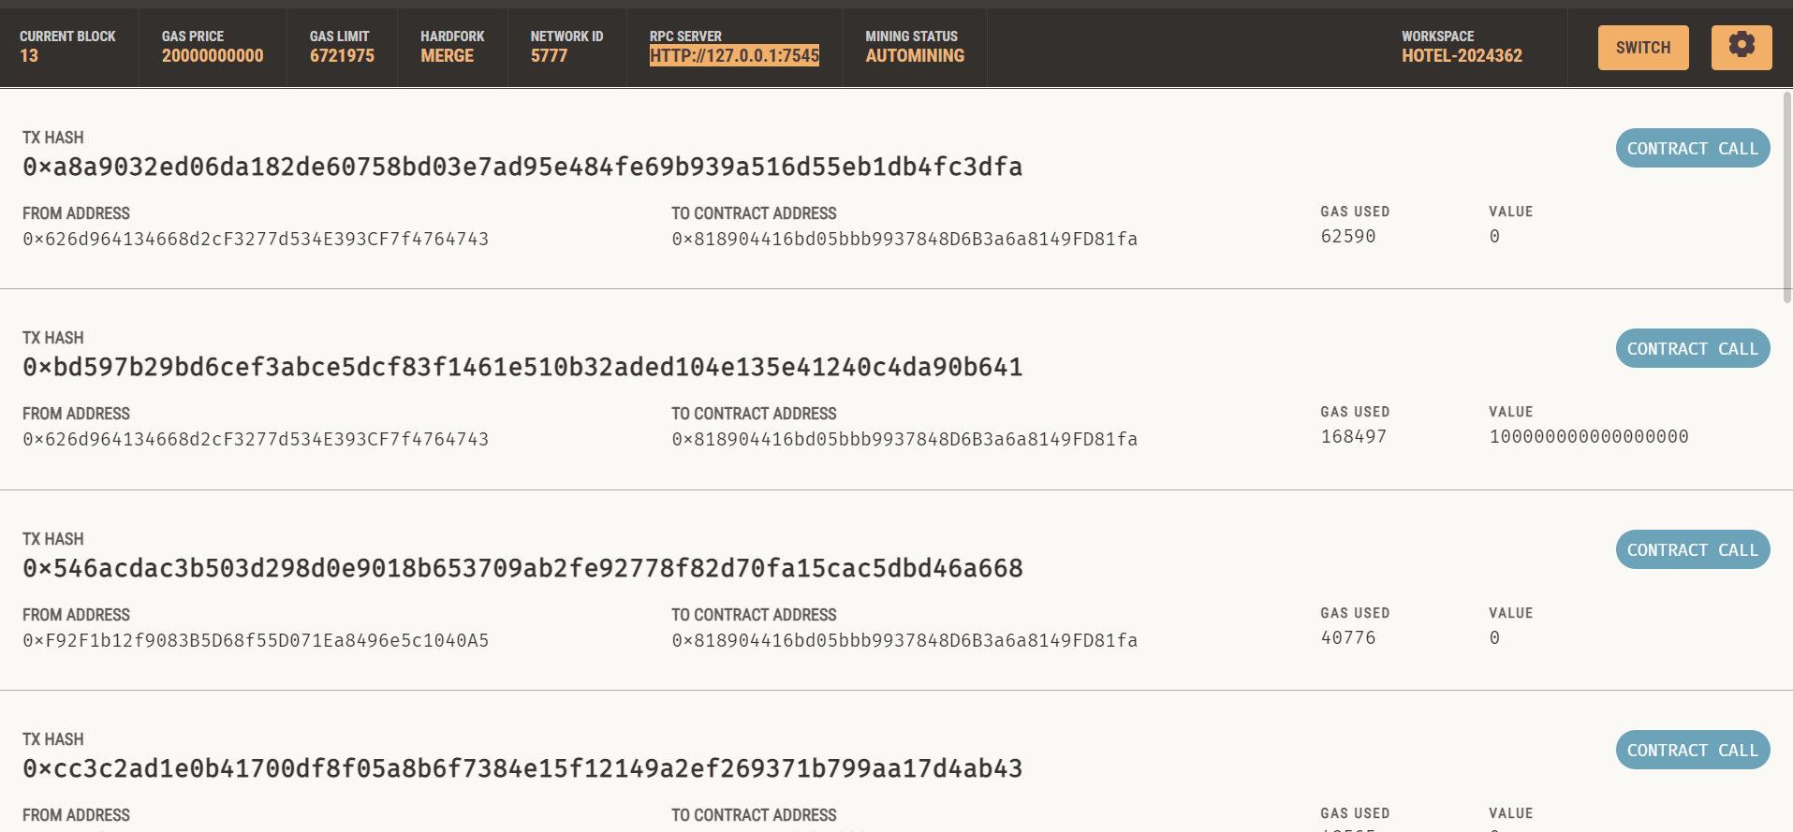
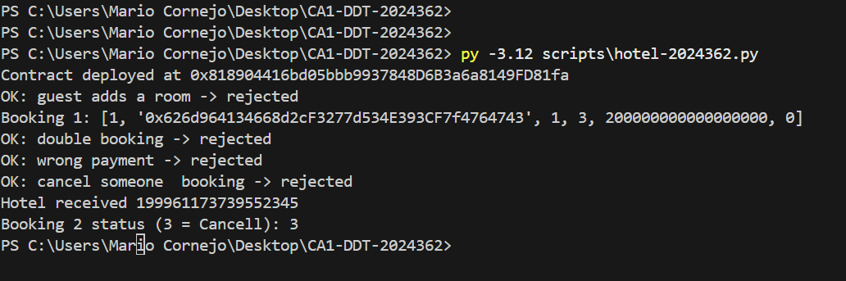
Blockchain-Based Hotel Booking
Mario Gerardo Cornejo Martinez | 2024362
HOTEL
Methodology
Testing
BASH
This work explains why hotel bookings must go through a secure process, since most are made online and many are for travel agencies. This means the hotel needs to control important data like payments and guest information.
For example:
If there are double bookings
Also for any commission over the payment
Problems with the booking and payment
Some refunds can be slow
The solution to some of these problems is a smart contract that was developed in Remix, which was helpful in developing some important tasks like the storage of rooms, check-in, check-out, etc.
For this assignment, the methodology was important to understand the aspects and how the current system can be related to the blockchain system.
For example: The website can be between the hotel and the guest, so the blockchain manages the contract that links them directly; that is why the contract was created in Remix to allow any requirement and transaction to be achieved. That can add some trust in the platform by adding auditable code, and also allows syncing between channels.
Some screenshots were taken as an example of how the contract works when some rooms are added.
One strong point is now the refunds and availability, now enforced automatically by code.
More testing was made using ganache and also visual studio
For testing, it was necessary to connected with ganache and make more room inputs and save some room numbers. At the beginning there were some errors.
A small piece of shell to launch the Python with just one command, making sure the contract is running and working. It was quite difficult to test and make it work
Some data was wrong with the bookroom
Why is need the blockchain?
The four questions below represent the core focus of the entire study:
Q.1. If a blockchain improve the current hotel system, and how is this implemented, such as by giving money back to guests
Q.2. Is blockchain appropriate for hotels to implement a good security system to avoid any problems like a data leak
Q.3 If a smart contract is necessary to help with the payments, to keep the data, and also to help with communication between the guest and the hotel.
Q.4 What limits can be applied in this environment using the blockchain
CONCLUSIONS
Smart Contract
It was built and tested as a working contract that lets guests book, cancel, and pay hotels directly, with the booking rules enforced on-chain.
Limitations: dates stored as day numbers; full refund on any cancellation; manual check-in by the hotel.
But with that in mind, it was important to understand how the blockchain and protection of data can be applied through a contract.
CONCEPTUAL FRAMEWORK
For the smart contract, the problem was thinking about how the booking has to pass through some third-party websites like online travel agencies, that charge commissions and can control the payment.
So the solution is a smart contract on Ethereum to keep the payment and release it to the hotel after checkout.
So the smart contract has 3 roles which are the client, hotel and the contract itself. With that in mind, functions were created like:
addRoom: To add the room number to the contract
- BookRoom: To allow the guest to book a room in the hotel
Cancel: Which allows the option to cancel the booking
Check-in: Hotel confirms the guest arrived
Checkout: To confirm the guest leaves
That improve the security avoiding any malicious contract to attack the and steal some money.
With this framework, we can show the code and the contract work for this environment of the Hotel Booking System, using the smart contract and cryptography, to check the challenges and also the testing to see if the contract can be compiled, and if there is any error, it can be fixed.
With the diagram is possible to understand of the hotel interact with the clients and contract using the system.
REFERENCES
Client
BookRoom
Buterin, V., Weiss, Y., Tirosh, D., Nacson, S., Forshtat, A., Gazso, K. and Hess, T. (2021) ERC-4337: Account abstraction using alt mempool. Available at: https://eips.ethereum.org/EIPS/eip-4337
CCT College Dublin (2026) Lecture 1: Introduction to blockchain technology [Lecture slides]. Distributed Digital Transactions, BSc (Hons) in Computing in IT. CCT College Dublin. Available at: Moodle
Ethereum.org (2026) What is layer 2? Available at: https://ethereum.org/en/layer-2/learn/
Solidity (no date) Security considerations. Solidity documentation. Available at: https://docs.soliditylang.org/en/latest/security-considerations.html
CCT College Dublin (2026) Lecture 3: Elliptic curve cryptography [Lecture slides]. Distributed Digital Transactions, BSc (Hons) in Computing in IT. CCT College Dublin. Available at: Moodle
Payment
Data Collection
Use of Python
The table below show how the data was input into the contract is show in the ganache for the test of the blockchain in the system.
Python was used to create an automatic test of the contract, and Visual Studio was used to check if the code worked.
Contract
Links
Hotel
.
Github:
Video:

